Slide 1
Memory Management

Slide 2
Computer System Functions
Execution
Execution of Program Instructions
Program stores data
Program needs memory to execute
Persistent Storage
Files
Memory
Program-related Data

Slide 3
Allocating Memory to Programs
OS Kernel
How to run multiple programs with limited memory?
Program
Program
?
Program
Program
Program
Program
Program
Program
Program
Program
Program
Main
Memory
Main memory is a limited resource
A program needs memory for execution
How to run multiple programs concurrently when only a few of them may be loaded into memory at the same time?

Slide 4
Concurrent Execution
OS Kernel
Persistent Storage
?
Memory Management
Program
Program
Program
Program
Program
Swapping
Program
Program
Program
Program
Program
Program
Program
Program
Program
Main
Memory
We need a memory management strategy to allow concurrent execution of programs

Slide 5
Core Concepts
Concurrency
Execution of programs concurrently
Virtualization of Processor
(processes, threads)
Principle: Context Switch
“Allotment of Time”
Virtualization
“Unlimited” resources and programs
Principle: Paging and Segmentation
“Allotment of Space”
Virtualization of Memory
(virtual address space)
Persistence
Storage of Data

Slide 6
Memory Management
Memory management is the effective allocation of memory to processes on a computer system
An operating system has five principal storage management responsibilities
Automated allocation
Virtualisation
Support for modular programming (segmentation)
Process isolation, protection and access control
Long-term storage

Slide 7
Memory Management
Main memory
Large array of bytes
Modern hardware architectures are “byte-addressable:
Each byte (8 bits) in memory can be addressed (accessed)
E.g.: a 32-bit processor architecture addresses 2³² bytes, which is 4 GiB
The word size depends on the processor architecture, it denotes the number of bits that the CPU can process at one time – it is the size of CPU registers (32-bit architecture have 32 bit words)
Volatile
Memory loses content in case of system failure

Slide 8
Contiguous vs Non-contiguous Allocation
Early approaches – contiguous allocation
Used partitioning of memory
Program (process image) fits into memory in its entirety
It occupies a contiguous block of physical memory
Modern approaches – non-contiguous allocation
Use paging and segmentation
A process lives in a logical address space that is mapped to a set of non-contiguous physical memory locations (page frames)
One process image occupies different blocks of physical memory
Needs a mapping between parts of the process image and the actual physical memory blocks where they are currently stored

Slide 9
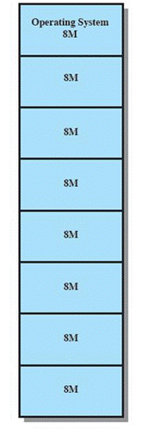
Partitioning
Early method of managing memory
Memory was divided into partitions to allow multiple programs to be held in memory simultaneously
Goal: better CPU utilisation, multitasking

Slide 10
Partitioning
A program is completely located in memory
Partitioning methods form the basis for modern memory management
Fixed partitioning
Dynamic partitioning
Partitioning creates problems, may need garbage-collection approaches
Buddy system

Slide 11
Fixed Partitioning
Main
Memory
OS Kernel
Persistent Storage
Memory Management
Swapping
Program
Program
Program
Program
Program
Program
Program
Program
Program
Program
Program
Program
Program
Program
Programs (process images) are swapped in and out of memory
If memory is full – which program to swap?

Slide 12
Fixed Partitioning Equal Partition Size
Static partitioning of physical memory
Memory organised as a set of fixed equal-sized partitions
No overlap of partitions
A program may be loaded into a partition of equal or greater size
Number of partitions determines how many programs may be loaded into memory simultaneously
When all partitions are occupied, operating system may swap programs in and out of partitions
Strength:
Simple to implement

Slide 13
Process Replacement, Swapping
Swapping and process replacement
If all partitions are allocated, a new process may have to wait for a partition to become free
Replacement decision: Programs may be swapped out to make partitions available for new programs
Which program / process is the best one to replace?
Relocation decisions: if process is swapped in
swapped into same partition as before? What about addresses used in program?
May need relocation mechanisms
Arrival of new process
Will be added to a waiting queue for memory allocation
Either one queue for all partitions or a separate queue for each partition

Slide 14
Addressing Memory
Programs need memory for execution
Programs must be loaded (by OS) into physical memory for execution
During execution, programs manipulate data
Program instructions refer to memory addresses
Load data into register, or write register back to memory
Program code must contain information about memory locations
OS Kernel
Processor
Instruction
Process
Program
Physical
Address
Data
Stack
Main
Memory

Slide 15
Program Relocation
A compiled program should be independent of physical memory locations
Programs must be executable at any location in memory
Program instructions refer to memory addresses
Load data into register, or write register back to memory
With dynamic schemes, programs can be relocated in memory
Addresses used in a program cannot be actual physical addresses
makes program relocation impossible
Use relative addressing: addresses used in program are offsets relative to the program’s start location

Slide 16
Relative Addressing – Using an Offset
Main
Memory
OS Kernel
Physical
Address A
Logical
Address L
Offset L
LOAD Reg, L
Instructions use logical Address L
Program
Physical
Address A
Physical
Address A + L
L
Data
Program
Program
Memory
Program
Solution:
Programs are programmed / compiled as if they always start at some imaginary address 0

Slide 17
Relative Addressing
Operating system works with relative addressing mechanism:
Reference to memory in program independent of actual physical location
Program instructions use logical addresses
Addresses in program are offsets from a base address (the starting address of the program in memory)
add the base address whenever there is an access to memory
We need an address translation mechanism (the memory management unit (MMU) in hardware) to translate logical addresses into actual physical memory locations

Slide 18
Relocation with Relative Addressing Logical vs Physical Addressing
Processes (programs in execution) should be able to reside at any location in memory
This is achieved by a virtual or “relative” addressing scheme, that calculates a “physical” memory address from the program-specific “logical” address
Logical address (also called “virtual” or “relative” address)
A value that specifies a generic location relative to the start of the program
Physical address
The actual address of a location in the physical memory of a computer system
OS Kernel
Processor
Logical
Address
Instruction
Process
Program
MMU
Physical
Address
Data
Stack
Main
Memory

Slide 19
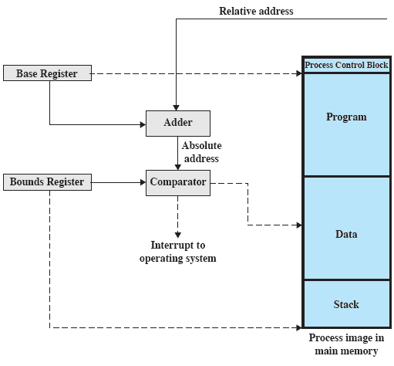
Relocation with Relative Addressing
Address translation with hardware
Two registers
Base register: physical start address of the process image in memory
Bound register: physical end address of the process image in memory

Slide 20
Problem: Memory Waste
“Not all programs are equal”
Programs may be of different size and, therefore, different memory requirements
We can load a program only into a partition that provide enough space
If program is smaller than partition – memory waste, cannot be allocated to another program
If a program is larger, we cannot run it

Slide 21
Problem: Internal Fragmentation
Inefficient use of main memory
Process image may not use the complete partition, some waste of memory inside the partition
Waste of memory: unused fragments of a partition cannot be given to other processes
This phenomenon is called internal fragmentation
Partition is not completely used
the block of data loaded (swapped in) is smaller than the partition
Whenever there is a fixed-size partitioning, internal fragmentation may occur

Slide 22
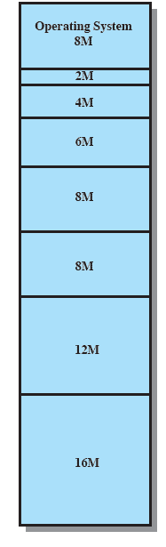
Fixed Partitioning, Unequal Size Minimize Internal Fragmentation
Using unequal partitions helps to lessen the problem of internal fragmentation
Partitions of different sizes pre-allocated in memory
Processes are placed into partitions where they fit best to minimize internal fragmentation
Tries to minimise internal fragmentation
Doesn’t solve the problem completely

Slide 23
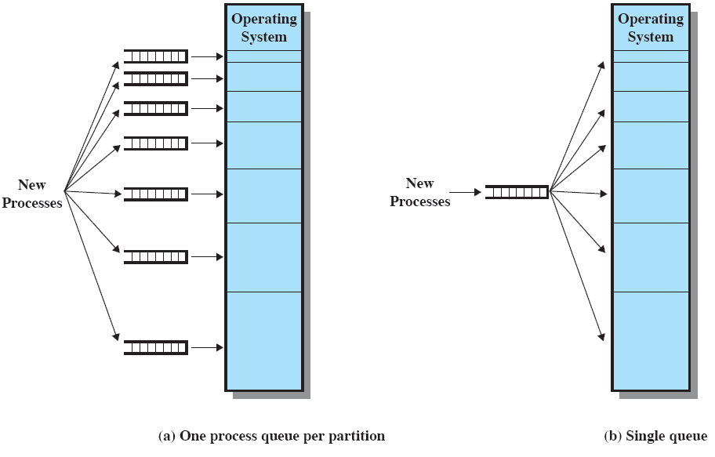
Process Replacement Memory Assignment Problem
Unequal size creates another problem: how to best assign a memory partition?
With unequal-size partitions, there are two possible ways to assign processes to partitions
One queue per partition, holding swapped-out processes that wait for this partition to become available again
One single queue for all

Slide 24
Dynamic Partitioning On-demand allocation of a Slice of Memory
No pre-partition at system start, memory is one contiguous partition
Processes that are swapped in are allocated the exact amount of memory needed
Partitions are of variable length and number
Have the exact size needed
Memory is allocated “on-demand” to processes
When a new process arrives or is swapped in, the exact amount of memory needed by the process is allocated as a partition
When a process terminates or is swapped out, the partition is released

Slide 25
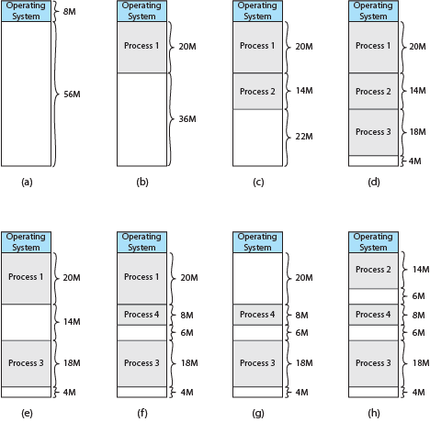
Effect of Dynamic Partitioning

Slide 26
Problem: External Fragmentation
Dynamic Partitioning
Over time, fragmentation of memory into smaller and smaller pieces occurs (“garbage”)
If a free contiguous space is large enough, it can be re-allocated for new processes
If free space is too small for new processes, it remains unused
Processes must wait for memory large enough to become available
External fragmentation
Waste of memory outside partitions, free memory areas too small for re-allocation
Whenever there is a variable-size partitioning, external fragmentation may occur

Slide 27
Strategy: Compaction
To overcome external fragmentation, a technique called Compaction was proposed:
This is a kind of “garbage collection”
partitions with assigned processes are shifted to collect free memory in one contiguous block
However: Compaction requires dynamic relocation capabilities in an operating system
It must be possible to move programs in memory and re-adjust their memory references
Is time consuming and a waste of CPU time

Slide 28
Dynamic Placement Strategies
Memory compaction is costly, therefore try to allocate free memory for processes intelligently
Three methods
Best-fit
Find the smallest partition needed
First-fit
Start scanning memory from its start address and take the first free block that is large enough
Next-fit
Continue scanning memory for free space from last allocation position

Slide 29
Buddy System
Tries to fix the problems of both static and dynamic partitioning
Combines fixed and dynamic partitioning scheme
Is either allocating a complete block that is small enough for a process or splitting a block into two equal “buddies” to get a better fit
Minimize internal fragmentation
Allows the creation of variable sized partitions, however the size of a partition is always 2^{N}
A relationship between these partitions is maintained

Slide 30
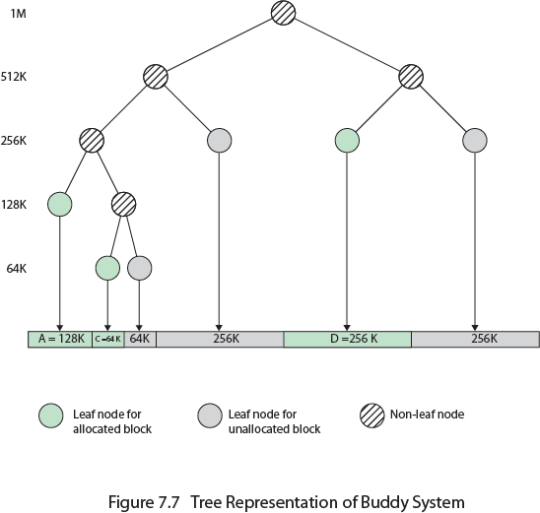
Tree Representation of Buddy System

Slide 31
Buddy System
(e.g. 1 kB = 2¹⁰ bytes)
2^{U}
2^{U-1}
2^{U-1}
(e,g. 512 bytes = 2⁹)
(e,g. 512 bytes = 2⁹)
Maintains relationship between partitions
If a partition itself is partitioned into two new and smaller partitions, then they are related
Related free partitions can be recombined into a larger contiguous space, as OS knows their relationship

Slide 32
Buddy System
Start: entire available space for allocation is treated as a single block of size 2^{U}
Process arrives, a memory block of size S is needed:
If for the request 2^{U-1} < S <= 2^{U} holds, then a block with size 2^{U} is allocated
Otherwise, the block of size 2^{U} is split into two “buddies” of size 2^{U-1}
This continues, until the smallest block greater or equal to the requested size S is allocated
If blocks become free, they can be recombined into the original contiguous blocks
This avoids memory fragmentation and the need for compaction

Slide 33
Buddy System
Waste
Internal Fragmentation
(e.g. 1 kB = 2¹⁰ bytes)
2^{U}
S = 100 kB
2^{U-1}
E.g.: need 100 kB, allocate next best 128 kB
(512 bytes = 2⁹)
When memory is allocated, it is always allocated in blocks of size 2^{K}, so that
2^{K} is the best fit for a requested memory of size S ≤ 2^{K}
If we have a block of size 2^{U} that is too large, it is split into two blocks of size 2^{U-1} and again it is tested again whether 2^{U-1} is a best fit for the requested memory of size S

Slide 34
Buddy System
Initially:
1 MB
Request: allocate 100 kB
2⁶ = 64kB
< 100 kB <=
2⁷ = 128kB
Split: create a 128kB partition
128 kB
128 kB
256 kB
512 kB
Allocate: load 100 kB into partition
128 kB
100 kB
128 kB
256 kB
512 kB
Internal fragmentation

Slide 35
Buddy System Example
Assume we have a system with 1MiB of memory.
Allocate 100KiB
Allocate 50KiB
Allocate 300KiB
Deallocate 50KiB
Allocate 200KiB
Deallocate 100KiB
What does memory look like?

Slide 36
Buddy System Example
Allocate 100KiB

Slide 37
Buddy System Example
Allocate 50KiB

Slide 38
Buddy System Example
Allocate 300KiB
Note: we can’t allocate more than 256 now even though 320 is free

Slide 39
Buddy System Example
Deallocate 50KiB (merging free portions of memory)

Slide 40
Buddy System Example
Allocate 200KiB

Slide 41
Buddy System Example
Deallocate 100KiB (and merge)

Slide 42
Memory Management Task
Memory virtualization
a process operates within a logical address space, large part of it held on hard disk, only small part is mapped onto actual physical memory
Replacement algorithms for loading those parts of a process that are currently needed
Responsibilities
Allocate and de-allocate physical memory
Efficient utilization of a limited memory resource
Keep track of which parts of physical memory are currently allocated to which process

Slide 43
Virtualization Memory Management
Computer
System
Persistent Storage
Virtual Memory
Paging
Segmentation
Physical Memory
File I/O
Frames
Page File

Slide 44
Virtual Memory Management
Non-contiguous allocation of memory for processes
The address space of a process is broken up into pieces or pages that don’t need to occupy a contiguous area of main memory
Processes only partially loaded into physical memory
Not all pages of a process image must be in physical memory at the same time
Process is only allowed to load a limited set of pages – “working set”
All memory references are logical addresses that are dynamically translated into physical addresses at run time
Mapping of address space onto physical memory
OS Kernel
Instruction
Process
Program
Data
Stack
Address
Space

Slide 45
Paging
Organise both virtual address space of process image and physical memory into fixed-sized blocks:
Pages: Virtual address space of a process is divided into equal fixed-sized blocks called “pages”
Frames: Physical memory is divided into equal fixed-sized blocks, called “frames” or “page frames”
Any page can be assigned to any free frame
The operating system allocates a small amount of frames to a process
Each process has a page table
Maps pages to frames – records the frames where a page is loaded

Slide 46
Paging
Allocation of pages to frames in physical memory can be arbitrary and non-contiguous
Page 0
0
Page 1
1
Page 0
Page Table
Page 2
2
0
1
Frames of physical memory
Page 3
1
4
3
Page 2
2
3
4
Page 1
3
7
5
6
Page N
7
Page 3
N
Virtual
Memory
Physical
Memory

Slide 47
Paging and Virtual Memory
Helps to implement virtual memory
Page file held on hard disk, organised in blocks of the same size as a page
Pages of a process can easily been swapped in and out of memory
Pages are loaded on demand
No time-consuming search for free best-fit memory fragments
No external memory fragmentation
Paging is supported by modern hardware

Slide 48
Page Table of a process
Process
Table
0
OS Kernel
1
2
Process
Control
Block
Process
Control
Block
Program
Process
Control
Block
Process
Control
Block
Data
0
Frame #
1
2
Frame # where page is loaded into memory
MAX
Stack
MAX
Memory
Address Space
Page Table

Slide 49
Page Table Management
Operating system manages one page table per process
A pointer to the page table is stored in the process control block
Context switch (starts a new process)
the stored page table of the process has to be referenced correctly
We can load a “page table pointer” into one of the processor registers and use it for address translation

Slide 50
Demand Paging
Virtualisation of memory management
Not all pages of a process must be in physical memory
A large part of the process image can be held on secondary storage
A page load mechanism is needed to load pages on demand
Only needed pages are loaded into memory
When program accesses memory, always first check whether page is in memory
If page is not loaded – “page fault”, leads to process interruption and I/O operations

Slide 51

Page Fault Handling
Program

Slide 52
Control Bits
Page table entries are annotated with control bits:
Present or valid bit: indicates whether a page is loaded into memory or not
Modify bit: indicates whether a page has been modified since it was loaded
If not, no need to write it out when it is replaced
Other bits may indicate read/write protection, whether a page is shared etc.
Frame #
valid-invalid bit
v
v
v
v
i
….
i
i
page table

Slide 53
Principle of Locality
References to memory locations tend to cluster.
E.g., accessing next element of array
By using paging, you are less likely to need another page soon, making virtual memory schemes (with their overheads) useful.
Only a small subset of a process’ memory is usually needed within RAM

Slide 54
Paging: Address Translation
An executing program uses a logical address for addressing memory locations
This logical address points to a particular location in virtual memory
Location within a virtual memory page
The logical address must contain information about the virtual memory page and the offset within this page

Slide 55
Paging: Address Translation
Logical address space: 2^{m}
Size of a page: 2^{n}
Number of pages: 2^{m-n}
Logical addresses have two parts
Page number (p)
Used as an index into the page table
An entry in this table contains the base address where a particular page is located in physical memory
Page offset (d)
Combined with the base address, defines the physical memory address within the space in memory occupied by the page
The high-order m-n bits encode the page number (index into page table), lower n bits encode the page offset
Size of page table

Slide 56
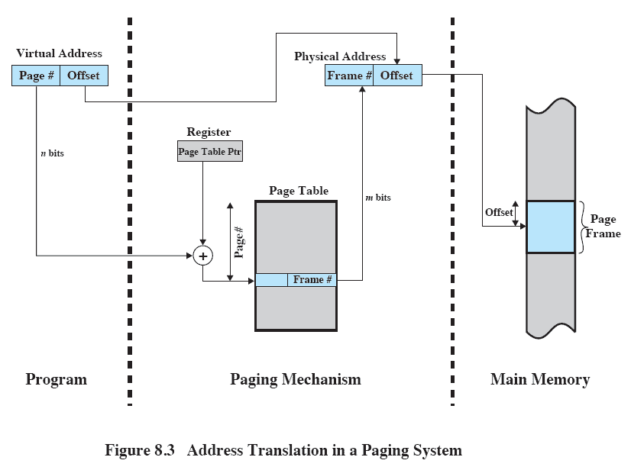
Paging: Address Translation

Slide 57
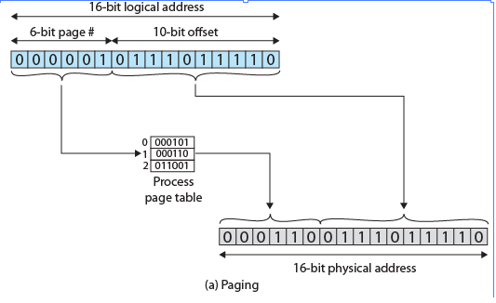
Address Translation
Size of page ?
Page number
Frame number
The physical address of memory location is generated by retrieving the physical base address of a page from the page table (index into page table contained in logical address) and combining it with the offset

Slide 58
Example: Calculate Logical Address
Let’s assume:
Virtual memory consists of 32 pages
A page is of size 2kB
Actual physical memory consists of 8 frames
How many bits needed for logical address?
Addressing virtual memory (logical address space):
How many bits?
Page size: 2kB = 2048 bytes = 2¹¹ bytes
We need 11 bits for the offset within a page
We have 32 = 2⁵ pages
We need 5 bits for the index in the page table (page number)
Logical Address: 16 bit

Slide 59
Example: Calculate Physical Address
Let’s assume:
Virtual memory consists of 32 pages
A page is of size 2kB
Actual physical memory only consists of 8 frames
How many bits needed for physical address?
Note: 1kB = 1024 bytes = 2¹⁰ bytes, 10 bits needed for addressing each byte within a page of size 1kB
Addressing physical memory:
How many bits for the physical address?
We need 11 bits for the offset within a frame (same size as page)
We have 8 = 2³ frames
We need 3 bits for addressing a frame (content of page table)
Physical Address: 14 bit

Slide 60
Example: From Logical to Physical Addresses
Assume a system with a page size of 2KiB and 512MiB of RAM. How many pages do we have?
512MiB=512x1024KiB. So a total of 2x512x1024 pages. (i.e., 1048576 = 1MiB of pages; we would need 20 bits to store this)
And another 11 bits for the offset.
Now assume we are given a logical address of 113204. What is the physical address?
113204 is what page number?
113204/2048 = 55.27… So page number 55
What is the offset? 113204-(55x2048)=564
Assume page 55 maps to frame 26.
26x2048+564=53812

Slide 61
Fragmentation
There is no external fragmentation
Any free frame can be allocated to a process that needs it
This is due to the correspondence between page size and frame size
There is internal fragmentation
As page / frame sizes are fixed, there may be some waste
The last frame allocated to a process may not be fully needed
Worst case: process may need n frames plus one additional byte! A complete additional frame must be allocated just for this additional byte of required memory
Expected internal fragmentation: on average one-half page per process

Slide 62
Resident Set
The resident set is the number of pages currently loaded into physical memory for a process
Is restricted by the number of frames the operating system allocates to a process (not an issue with 64 bit OSs)
Fetch, replacement and placement policies decide when a page should be loaded or replaced in memory, and where the page should be loaded.

